Slide 1
Assessing the impact of social media on mental health
  Presented by EDIMA UDOUKPONG

Slide 2
Background/objectives
Social media has become an integral part of daily life for people of all ages. However, increased screen time and constant online engagement have raised concerns about their effects on mental health, sleep quality, and stress levels.
This analysis examines how various social media behaviors impact mental health outcomes, utilizing data analytics and visualization techniques to provide evidence-based insights.
Objectives
To analyze the relationship between screen time and mental health risk
To examine how age groups differ in their vulnerability to social MEDIA-RELATED MENTAL HEALTH EFFECTS.
TO evaluate the influence of digital detox behaviors on stress, sleep quality, and happiness
To assess the role of exercise as a protective factor against mental health risk
To identify high-risk groups and patterns that can inform healthier digital habits.

Slide 3
Data fields
kpi’s
Total number of users - 117
Average daily screen time use(hours) – 5.13hrs
Average mental health risk score(%) – 44%
Mental health risk category – (<34-low risk, 34-65-moderate risk, >= 65 -high risk)
Social media platforms - Instagram, Facebook, TikTok, LinkedIn, Twitter, YouTube
Age groups –((16-19{teens}, 20-29{young adults},30-39{adults}, >=40{older adults})
Screen time category – (7-9hrs{high}, 1-3{low}, 4-6{moderate})
Stress level category – (0-3{low}, 4-6{medium}, 7-10{high})
Happiness level – (8-10{high}, 4-7{moderate})
Detox level – (1-3{short break}, 4-7(long break, 0{none})
Sleep quality category – (0-4hrs{poor}, 5-6hrS{fair}, 7hrs and above {good})
User information
User id
Age
Gender
Daily screen time(hours)
Sleep quality(1-10)
Stress level(1-10)
Days without social media
Exercise frequency
Social media platform
Happiness index(1-10)

Slide 4
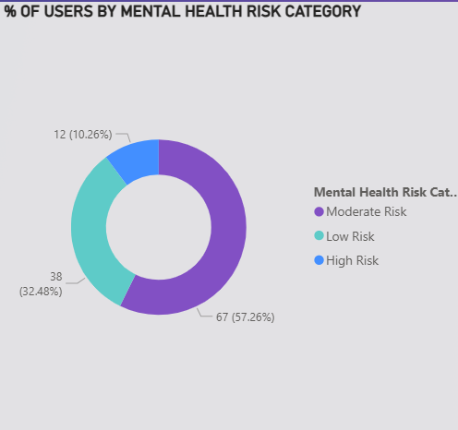
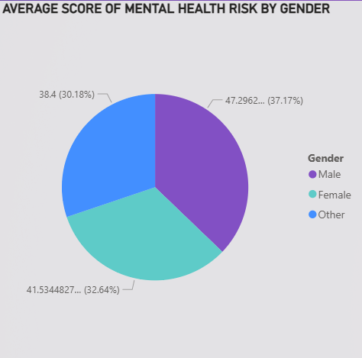

Slide 5
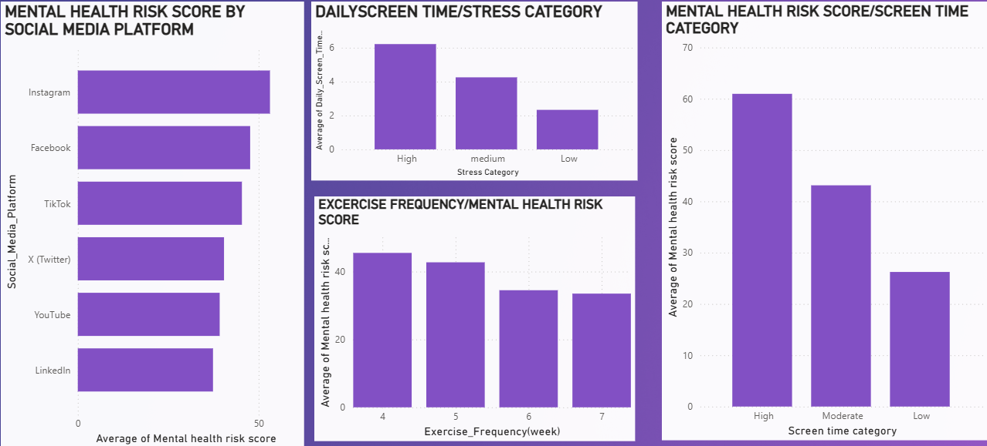

Slide 6
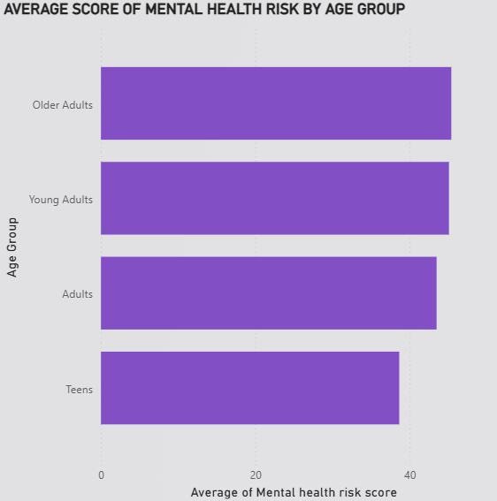
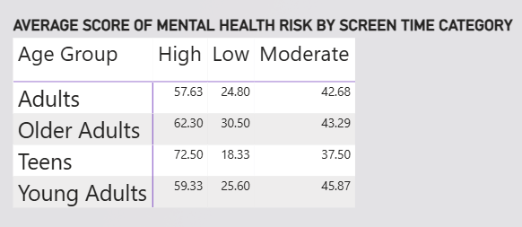

Slide 7
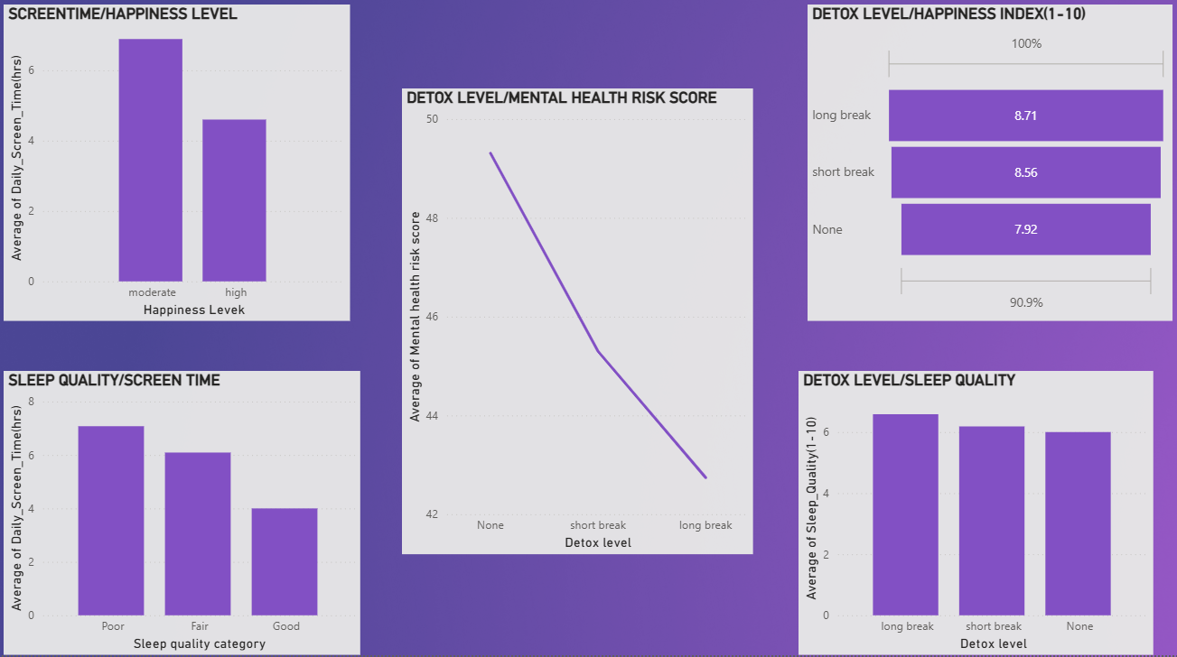

Slide 8
Key findings
The analysis examined the relationship between social media usage and mental health outcomes across 117 users.
The average daily screen time was 5.13 hours, while the average mental health risk score stood at 44%, indicating a moderate overall risk level.
In terms of risk distribution, 10% of users were classified as high risk, 57% as moderate risk, and 32% as low risk.
Male users exhibited the highest mental health risk (37%), followed by female users (32%), while users identifying as neither male nor female recorded the lowest risk (30%).
Platform-based analysis revealed that Instagram was associated with the highest mental health risk, followed by Facebook, whereas LinkedIn, a professional platform, showed the lowest risk.
A clear positive relationship was observed between screen time and stress levels, with higher screen time leading to increased stress and a higher mental health risk score.
Exercise frequency showed a protective effect, as users who exercised more frequently per week exhibited lower mental health risk.
By age group, older adults recorded the highest mental health risk, while teenagers had the lowest overall risk. However, further analysis showed that teenagers with high screen time faced a significantly elevated risk of up to 72%.
Digital detox analysis indicated that users who did not take any break from social media had the highest mental health risk, followed by those who took short breaks. Users who took longer breaks experienced the lowest risk.
A similar pattern was observed for happiness and sleep quality, where longer social media breaks were associated with higher happiness levels and better sleep, while increased screen time was linked to poorer sleep quality.

Slide 9
conclusion
Overall, the analysis demonstrates that prolonged social media use is strongly associated with increased mental health risk, particularly through higher stress levels, poorer sleep quality, and reduced well-being. While certain demographic groups, platforms, and usage patterns show higher vulnerability, the findings also highlight the importance of protective behaviors such as regular exercise and intentional digital breaks. These results suggest that healthier social media habits, combined with balanced lifestyle choices, can significantly reduce mental health risks and improve overall well-being.

